Slide 1
Ad-Hoc Testing
Application - SreeLeathers
Prepared By - Mahe

Slide 2
Ad-Hoc Testing
Without any planning and documentation.
Conducted informally and randomly
Software Testing Technique - Error Guessing

Slide 3
Bug Report:
Project Name
Tested By
Tested on
Priority
Severity
Title
Steps to Reproduce
Expected Results
Actual Results

Slide 4
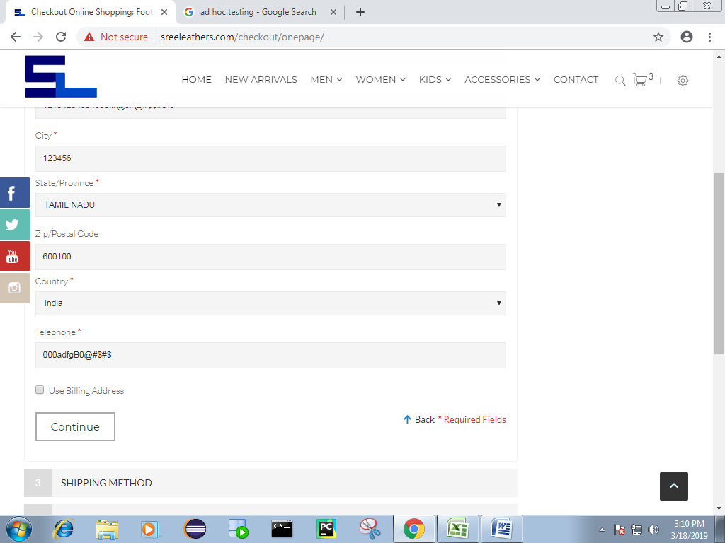
Priority: Low Severity: Low Bug : Telephone number field is accepting special characters and alphabets

Slide 5
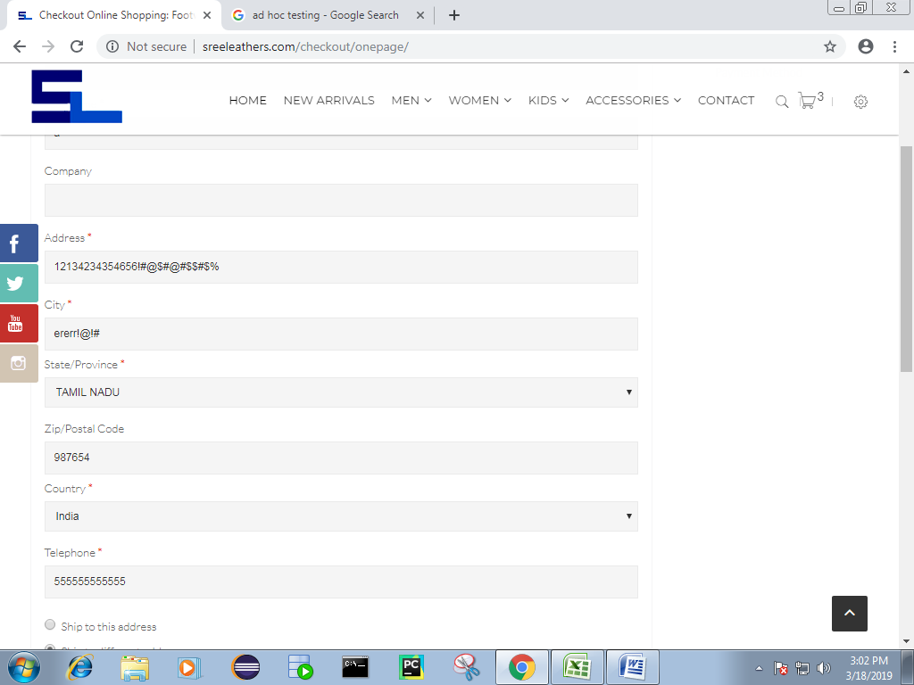
Priority :Low Severity :Low Bug : City field is accepting Special characters and numbers.

Slide 6
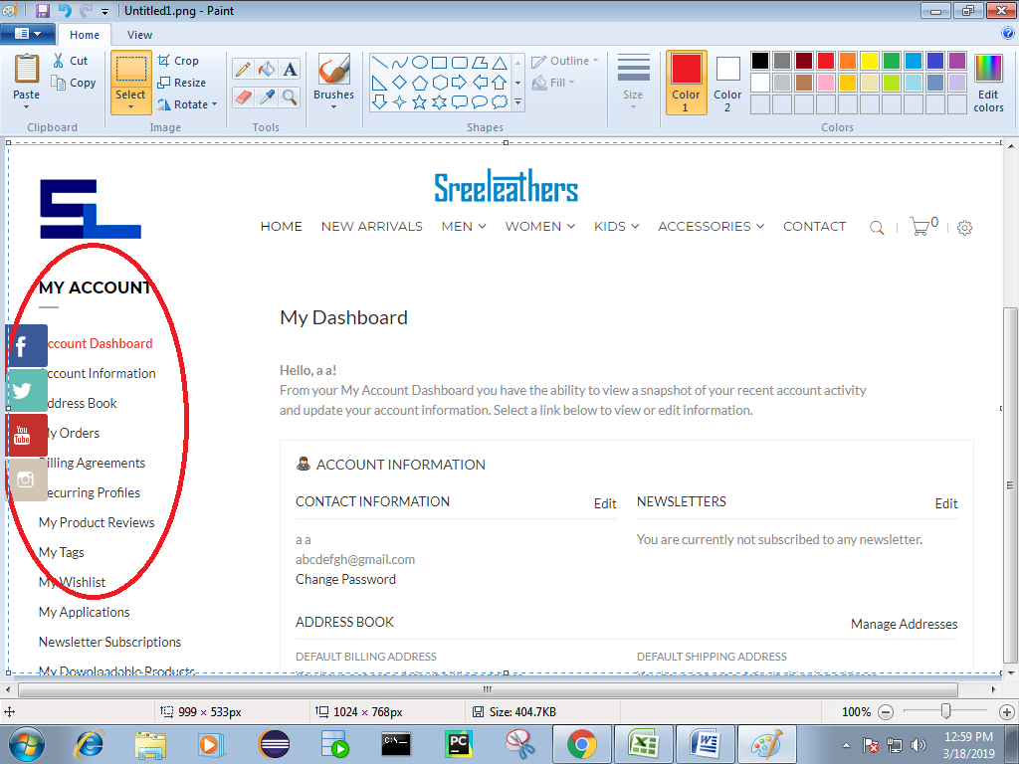
Priority: High Severity : Low Bug: Shortcut keys are hiding the list inside My Account

Slide 7
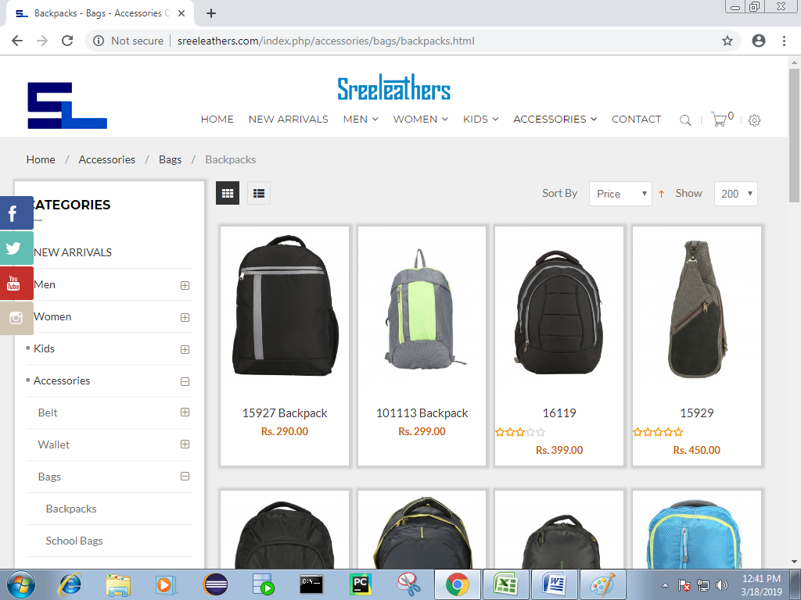
Priority : High Severity : High Bug : Navigating to the wrong page from Homepage

Slide 8
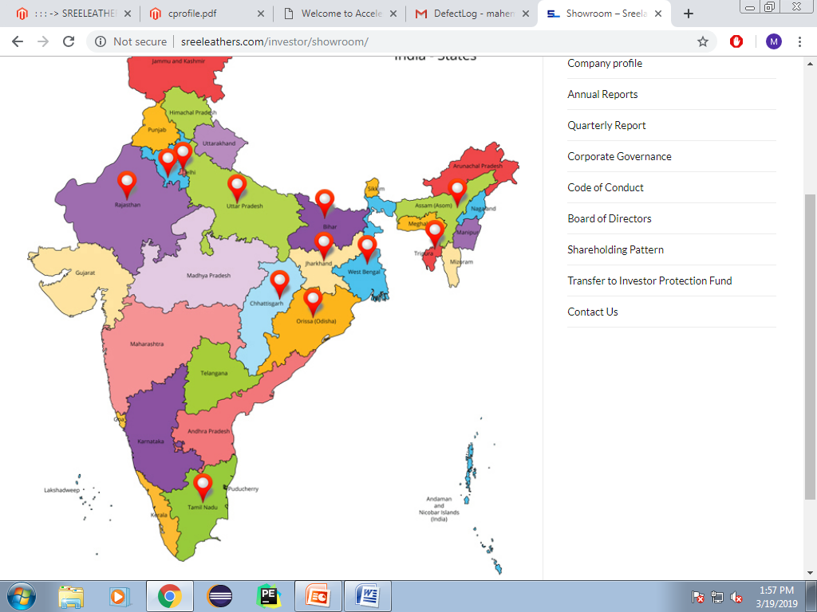
Priority : High Severity : High Bug : Cannot locate Tamilnadu address from Store locations

Slide 9
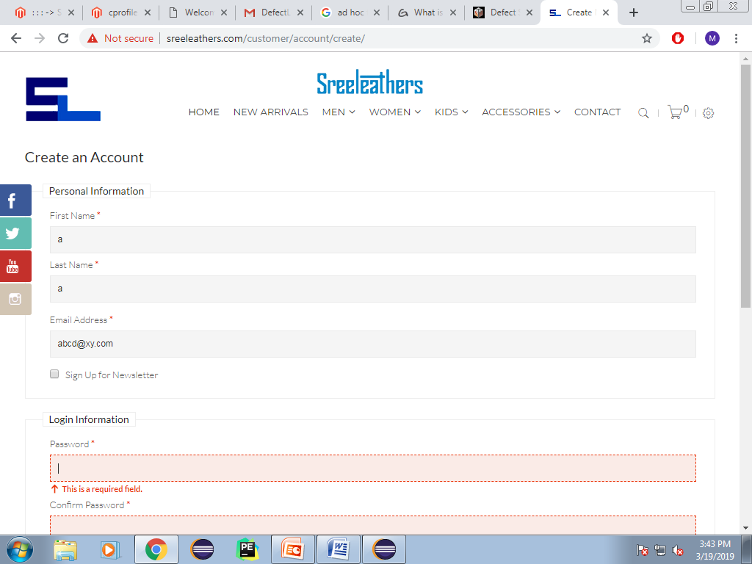
Priority : High Severity : High Bug : Accepting wrong domain name in email id field in Create an Account

Slide 10
Thank You

